Slide 1
Routing Protocols In Wireless Sensor Network

Slide 2
Difference between Routing Protocols of Wireless Networks and WSN
No global addressing scheme - IP-based protocols may not be applied
Getting the data is more important than knowing the IDs of which nodes sent the data.
Flow of sensed data from multiple sources to a particular BS.
Low energy, processing and storage capacities
Once deployed mostly the sensors are immobile
Sensor networks are application specific – design requirement changes with application
Position awareness is important since data collection is based on location
Data collected has high probability of redundancy since the data is collected based on some common phenomena (Data aggregation is necessary)
Notes:
Routing in WSNs is challenging due to the inherent characteristics that distinguish these networks from other wireless networks like mobile ad hoc networks or cellular networks.
First, due to the relatively large number of sensor nodes, it is not possible to build a global addressing scheme for the deployment of a large number of sensor nodes. Thus, traditional IP-based protocols may not be applied to WSNs. In WSNs, sometimes getting the data is more important than knowing the IDs of which nodes sent the data.
Second, in contrast to typical communication networks, almost all applications of sensor networks require the flow of sensed data from multiple sources to a particular BS.

Slide 3
The task of finding and maintaining routes in WSNs is nontrivial since energy restrictions and sudden changes in node status (e.g., failure) cause frequent and unpredictable topological changes.
To minimize energy consumption,
routing strategies employed are:
data aggregation
in-network processing,
clustering,
different node role assignment,
and data-centric methods.

Slide 4
Routing Challenges and Design Issues in WSNs

Slide 5
Overview
Node deployment
Energy considerations
Data delivery model
Node/link heterogeneity
Fault tolerance
Scalability
Network dynamics
Transmission media
Connectivity
Coverage
Data aggregation/convergecast
Quality of service

Slide 6
Node Deployment
Node deployment in WSNs is application dependent and affects the performance of the routing protocol.
The deployment can be either deterministic or randomized.
In deterministic deployment, the sensors are manually placed and data is routed through pre-determined paths.
In random node deployment, the sensor nodes are scattered randomly creating an infrastructure in an ad hoc manner.
Notes:
Node deployment in WSNs is application dependent and affects the performance of the routing protocol.
The deployment can be either deterministic or randomized.
In deterministic deployment, the sensors are manually placed and data is routed through pre-determined paths.
In random node deployment, the sensor nodes are scattered randomly creating an infrastructure in an ad hoc manner. If the resultant distribution of nodes is not uniform, optimal clustering becomes necessary to allow connectivity and enable energy efficient network operation.

Slide 7
Energy Considerations
Because of limited supply of energy, energy-conserving forms of communication and computation are essential.
In a multi-hop WSN, each node plays a dual role as data sender and data router. The malfunctioning of some sensor nodes due to power failure can cause significant topological changes and might require rerouting of packets and reorganization of the network.

Slide 8
Data Delivery Model
Time-driven (continuous)
Suitable for applications that require periodic data monitoring
Event-driven
React immediately to sudden and drastic changes
Query-driven
Respond to a query generated by the BS or another node in the network
Hybrid
The routing protocol is highly influenced by the data reporting method
Notes:
資料回報可以分成三個種類
1定時週期的回報
2.偵測到事件回報
3.由BS發出要求、再回報
這三種回報的方式都會被能源消耗、和Routing的計算影響

Slide 9
Node/Link Heterogeneity
Depending on the application, a sensor node can have a different role or capability.
The existence of a heterogeneous set of sensors raises many technical issues related to data routing.
Even data reading and reporting can be generated from these sensors at different rates, subject to diverse QoS constraints, and can follow multiple data reporting models.
Notes:
根據用途的不同、Sensor會有不同的性質和不同能力
但異質性的感測節點，再傳輸的過程當中（Routing方面），也衍生出了一些問題，
例：因為不同性質節點會有不同的QoS限制

Slide 10
Fault Tolerance
Some sensor nodes may fail or be blocked due to lack of power, physical damage, or environmental interferences
It may require actively adjusting transmission powers and signaling rates on the existing links to reduce energy consumption, or rerouting packets through regions of the network where more energy is available
Notes:
有些能源會因為能源不足，或是損壞、環境的因素而失效，
1.調整傳輸功率、頻率去減少能源讓費
2.重新改變傳送的packet

Slide 11
Scalability
The number of sensor nodes deployed in the sensing area may be on the order of hundreds or thousands, or more.
Any routing scheme must be able to work with this huge number of sensor nodes.
In addition, sensor network routing protocols should be scalable enough to respond to events in the environment.
Notes:
因為Sensor的數量可以從幾百個～幾千個，
再Routing的設計方面必須要考量到大數量的以及適應相對的環境。

Slide 12
Network Dynamics
Routing messages from or to moving nodes is more challenging since route and topology stability become important issues
Moreover, the phenomenon can be mobile (e.g., a target detection/ tracking application).
Notes:
移動節點導致拓樸的動態改變，也是一個議題
Table detection
Tracking 都視為可以移動的現象
所以Routing對於這方面也要能夠有相對應的調整。

Slide 13
Transmission Media
In general, the required bandwidth of sensor data will be low, on the order of 1-100 kb/s. Related to the transmission media is the design of MAC.
TDMA (time-division multiple access)
CSMA (carrier sense multiple access)
Notes:
再無線傳輸頻道的部份，也會影響到routing
所以在MAC層也有相對應的設計 TDMA CSMA

Slide 14
Connectivity
High node density in sensor networks precludes them from being completely isolated from each other.
However, may not prevent the network topology from being variable and the network size from shrinking due to sensor node failures.
In addition, connectivity depends on the possibly random distribution of nodes.
Notes:
為了讓連接性有一定的程度（避免某些節點孤立）
會需要高密度的節點數量，
但高密度的節點，會無法避免node的失效所帶來的拓樸變化，
此外、連接性也會依靠這些隨機分佈的節點來建立。

Slide 15
Coverage
In WSNs, each sensor node obtains a certain view of the environment.
A given sensor’s view of the environment is limited in both range and accuracy.
It can only cover a limited physical area of the environment.
Notes:
每一個Sensor都有自己的偵測範圍（受到物理條件的限制）
再routing的時候也會考量覆蓋率的部份

Slide 16
Data Aggregation/Convergecast
Since sensor nodes may generate significant redundant data, similar packets from multiple nodes can be aggregated to reduce the number of transmissions.
Data aggregation is the combination of data from different sources according to a certain aggregation function.
Convergecasting is collecting information “upwards” from the spanning tree after a broadcast.
Notes:
Data aggaregation會把多餘（重複性質的data）從不同的Sensor收集 可以減少傳送次數
Covergast利用Spanning tree把收集到的資料向上傳，所以Route的結構就非常重要

Slide 17
Quality of Service
In many applications, conservation of energy, which is directly related to network lifetime.
As energy is depleted, the network may be required to reduce the quality of results in order to reduce energy dissipation in the nodes and hence lengthen the total network lifetime.
Notes:
為了讓能量的消耗降低，有時後會把通訊品質下降，同時延長整體網路壽命

Slide 18
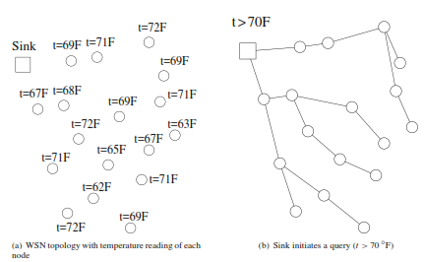
Example for Data-Centric Routing

Slide 19
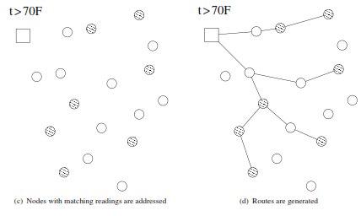

Slide 20
Examples of Protocols that apply Data-Centric Principle
Flooding
Gossiping
Sensor Protocols for Information via Negotiation (SPIN)
Directed Diffusion
Energy-aware Routing protocol
Rumor routing
Gradient-based Routing
CADR
COUGAR
ACQUIRE
Shortest Path Minded SPIN (SPMS)
Solar-aware Routing

Slide 21
Flooding
Reactive Protocol
Each node Which receives a packet broadcasts it, if the maximum hop count of the packet is not reached.
Advantages:
Simplicity
Does not require complex topology maintenance
Does not require complex route discovery algorithms
The disadvantages of flooding are :
Implosion – Many copies of the same message through different routes
Overlap – If two nodes have overlapping sensing regions, both will sense the same stimuli and hence neighbouring nodes receive the duplicate messages
Resource Blindness – Never considers the about the limited availability of energy

Slide 22
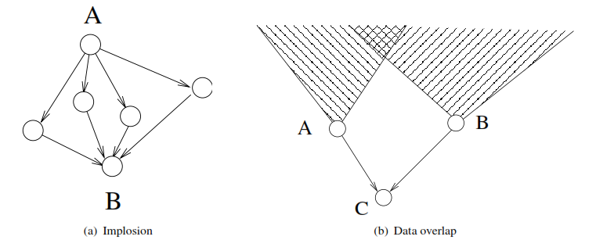
Disadvantages of Flooding

Slide 23
Gossiping
Gossiping is modified version of flooding.
The nodes send packets to a randomly selected neighbor to avoid Implosion.
Advantages:
Avoids implosion
Energy consumption is less than flooding
Disadvantages:
Less Reachability - does not guarantee that all the nodes of the network will receive the message.
Higher Latency to propagate throughout the network.

Slide 24
SPIN
SPIN stands for Sensor Protocol for Information via Negotiation.
SPIN uses negotiation and resources adaption to address the deficiencies of flooding.
Negotiation reduces overlap and implosion.
Meta-data is transmitted instead of actual data.
SPIN has three types of messages : ADV, REQ and DATA.

Slide 25
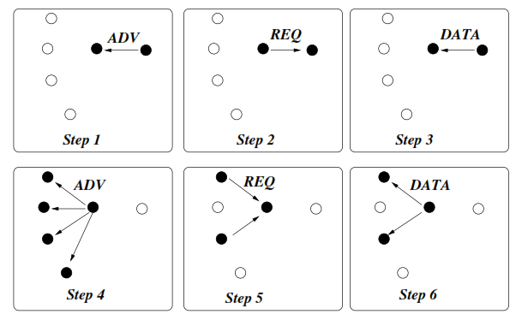
SPIN Protocol

Slide 26
Advantages:
Avoids implosion, less energy consumption than flooding, Scalable
Disadvantages
Does not address Resource blindness problem, Higher latency
Types
SPIN(PP)-Point-to-Point
SPIN(EC)-Low energy sensors does not participate in Negotiation
SPIN(BC)- with randomized back off mechanism - If any one REQ packet is heard, others will not send REQ packet, but waits for DATA packet
SPIN(RL)-If ADV packet is heard but no DATA packet is followed by it, retransmission of DATA packet is requested from the neighborhood that may have already received the DATA packet

Slide 27
Direct Diffusion
Useful where the sensor nodes themselves generate requests/queries for data sensed by other nodes.
Stages : Interest Propagation, Gradient Set up, Reinforcement, Data Delivery
Each sensor node names its data with one or more attributes and other nodes express their interest depending on these attributes.
Data is propagated along the reverse path of the interest propagation.
Each path is associated with a gradient that is formed at the time of interest propagation.
The interest cache has timestamp, gradient, interval and duration
Timestamp-Local time when the interest is received
Gradient-The node from which the interest is received
Interval and duration- How long the interest need to be stored
The gradient corresponding to an interest is derived from the interval/data-rate field specified in the interest.
This model uses data naming by attributes and local data transformation to reflect the data centric nature of sensor network operations.

Slide 28
Directed Diffusion
Since the gradient setup phase does not limit the number of gradients that a node may have, the source node may have several gradients for the same interest.
The data can be sent through multiple routes to the sink.
In this case, the sink can reinforce a particular path by resending the interest through the speciﬁed node in that path.
Path selection may be according to
best link quality,
number of packets received from a neighbor, or
lowest delay.
Once speciﬁed node is selected, the interest is sent only to that node to reinforce the path associated with the node. Each node along this path forwards the reinforcement to its next hop.
Finally, a route between source and sink is established
Sink may also select multiple paths during reinforcement – Multipath delivery
Two-phase pull diffusion vs Push-Diffusion

Slide 29
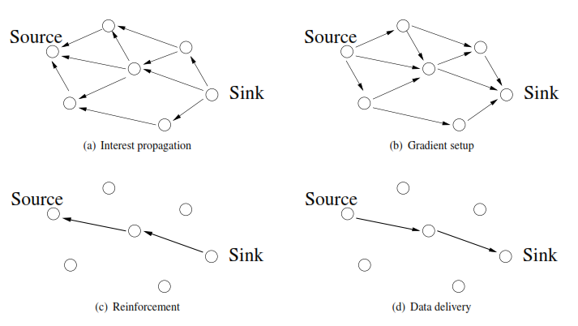
Directed Diffusion

Slide 30
Qualitative Evaluation- Advantages
Data-centric routing protocols provide application-dependent routes based on the interests of the user.
A data-centric mechanism is used to determine end-points in the network, which results in a dynamic operation.
Whenever the sensor readings change, the network routes are adapted to these changes to satisfy the user’s requests.
Since a data-centric mechanism is used, a global node addressing mechanism is not required. This provides energy efﬁciency since the routes are constructed only when there is an interest and there is no need to maintain a global network topology.
Data-centric solutions also decrease energy consumption in the network by specifying selected routes for a speciﬁc interest from the sink. Hence, only those nodes that have matching information are involved in information generation.

Slide 31
Qualitative Evaluation-Disadvantages
Data-centric routing protocols are generally based on a ﬂat topology. This causes scalability problems as well as increased congestion among the nodes closer to the sink.
Distributed aggregation mechanisms are necessary to decrease the information content ﬂowing in each part of the network.
Protocols such as directed diffusion are applicable to a subset of applications in WSNs, since the communication is initiated by queries generated from the sink. This also makes directed diffusion not a good choice for dynamic applications, where continuous data delivery is important.
The query types as well as the interest matching procedures need to be deﬁned for each application.
The data-centric approach results in application-dependent naming schemes. Accordingly, for each change in the application, these schemes should be deﬁned a priori.
Finally, the matching process for data and queries causes some overhead at the sensors.

Slide 32
Disadvantages of Flat-architecture Protocols
The data-centric and ﬂat-architecture protocols result in the majority of the information generated at the sensors being concentrated near the sink.
Flat-architecture protocols suffer from data overload close to the sink as the density increases. The nodes which are located near the sink route more information than nodes in other parts of the network. Hence these nodes die faster and produce a disconnection between the sink and the WSN.
Flat-architecture protocols result in uneven energy consumption throughout the network and limit the scalability of the protocols.

Slide 33
Hierarchical Protocols
The nodes are grouped in clusters and the local interactions between cluster members are controlled through a cluster head
Addresses the scalability and energy consumption challenges of WSNs.
Sensor nodes form clusters where the cluster heads aggregate and fuse data to conserve energy. The cluster heads can also form another layer of clusters among themselves before reaching the sink.
Examples
Low-energy adaptive clustering hierarchy (LEACH)
Power-efﬁcient gathering in sensor information systems (PEGASIS)
Threshold-sensitive energy-efﬁcient sensor network (TEEN)
Adaptive threshold-sensitive energy-efﬁcient sensor network (APTEEN)

Slide 34
LEACH
Aims to minimize energy consumption through a cluster-based operation.
Goal - To dynamically select sensor nodes as cluster heads and form clusters in the network. The communications inside the clusters are directed to the cluster head, which performs aggregation.
Cluster heads directly communicate with the sink to relay the collected information from each cluster.
Changes the cluster head role dynamically such that the high-energy consumption in communicating with the sink is spread to all sensor nodes in the network.
The operation of LEACH is controlled through rounds, which consist of several phases.
During each round, each cluster formation stays the same, and the cluster heads are selected at the beginning of each round.
A round is separated into two phases, the setup phase and steady state phase.

Slide 35
Setup phase – Cluster heads Selection and cluster formation, Cluster Communication Schedule Determination.
Steady state phase - Data communication between cluster members and the cluster head
To minimize overhead → Duration of the steady state phase is longer than the duration of the setup phase
Setup phase consists of three phases: advertisement, cluster setup, and schedule creation.
Randomly selects sensors as cluster heads during the beginning of each round.
Cluster head selection is performed through the advertisement phase → Sensor nodes broadcast a cluster head advertisement message.

Slide 36

Sensor node chooses a random number (rno) between 0 and 1.
If rno < T(n) (threshold), sensor node becomes a cluster head.
P - Desired % to become a cluster head,
r – Round No.,
G - Set of nodes that have not been selected as a cluster head in the last 1/P rounds
Selected cluster heads advertise to their neighbors in the network that they are the new cluster heads. (Uses CSMA)
Sensor nodes upon receiving the advertisement, determine the cluster that they belong to.
Receives from a single cluster head →Becomes a member of that cluster.
Receives from multiple cluster heads → Chooses the cluster head with the highest signal strength

Slide 37
In cluster setup phase, the sensor nodes inform the associate cluster head that they will be members of the cluster
In schedule creation phase the cluster heads assign the time during which the sensor nodes can send data to the cluster heads based on a time division multiple access (TDMA) approach
Then it goes into steady state phase in which the sensor nodes can begin sensing and transmitting data to the cluster heads.
The cluster heads aggregate data from the nodes in their cluster before sending these data to the sink.
At the end of the steady state phase, the network goes into the setup phase again to enter into another round of selecting the cluster heads.
Energy consumption due to the cluster head duty is equally distributed among sensor nodes.

Slide 38
Advantages and Disadvantages
The cluster-based operation of LEACH improves the energy efﬁciency of WSNs.
During the steady state phase, only the cluster heads are active all the time.
A cluster member in a cluster is active only during its allocated time slot and the setup phase.
Hence the energy consumption of a regular node is minimized signiﬁcantly.
Because of periodic cluster head selection, the energy consumption burden of the cluster head nodes is also shared.
Provides a factor of 4–8 reduction in energy consumption compared to a ﬂat-architecture routing protocol.

Slide 39
PEGASIS
Aims to address the overhead caused by the cluster formation in LEACH by constructing chains of nodes instead of clusters
The chain construction is performed according to a greedy algorithm, where nodes select their closest neighbors as next hops in the chain.
The nodes have a global knowledge of the network and the chain construction starts from the nodes that are farthest from the sink.
Each node only keeps track of its previous and next neighbor in the chain.
Communication in the chain is performed sequentially such that each node within a chain aggregates data from its neighbor until all the data are aggregated at one of the sensor nodes, i.e., chain leader.
The chain leader controls the communication order by passing a token among the nodes.

Slide 40
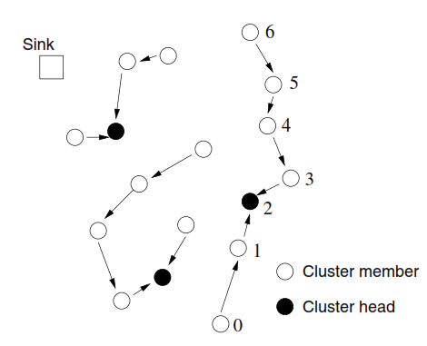
Chain leader - Node 2
Node 2 passes the token to node 0 to initiate communication.
Node 0 → data →Node 1, Node 1 → aggregates with its own data → Node 2.
Node 2 passes the
token to the other end of the chain, Node 6. Information from nodes 6, 5, 4, and 3 is aggregated and sent to node 2
Node 2 uses a single hop communication to transmit the data to the sink.

Slide 41
PEGASIS
Assumes that all sensor nodes know the location of every other node.
Any node has the required transmission range to reach the BS in one-hop, when it is select as a leader.
Goals
Minimize the distance over which each node transmits.
Minimize the broadcasting overhead.
Minimize the number of messages that need to be sent to the BS.
Distribute the energy consumption equally across all nodes.

Slide 42
A greedy algorithm is used to construct a chain of sensor nodes, starting from the node farthest from the sink.
At each step, the nearest neighbor which has not been visited is added to the chain.
At every node, data fusion is carried out so that only one message is passed on from one node to next.
The leader finally transmits one message to sink.
The delay involved in message reaching the sink is O(N), where N is the total number of nodes in the network.

Slide 43
TEEN and APTEEN
Provides event-based communication
Thresholds
Soft Threshold (S_{T})
Hard Threshold (H_{T})
Sensed value is compared with H_{T.} If exceeds the value is transmitted to cluster head
To reduce redundancy, if difference between consecutive observations exceeds S_{T} then transmit
TEEN uses fixed thresholds, APTEEN uses both periodical and threshold s for transmission
APTEEN follows TDMA based structure for transmission
Soft and hard thresholds determines how frequently the data has to be sent

Slide 44
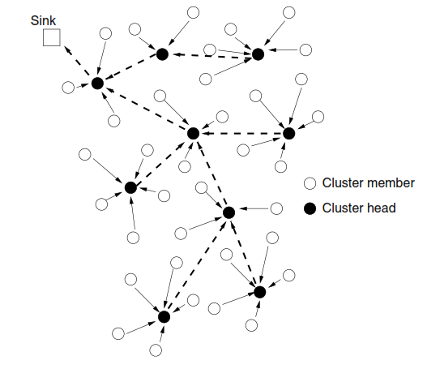
Hierarchical Structure of TEEN and APTEEN

Slide 45
Qualitative Evaluation
Advantages
Provides scalability in the network by limiting most of the communication inside the clusters.
Trafﬁc generated in the network can be limited by the cluster heads.
Dynamic clustering mechanisms result in better energy efﬁciency compared to ﬂat topology protocols.
In event-based WSNs, most of the sensors can be put to sleep with the help of the cluster heads.
Intelligence is passed to a small number of cluster heads and the rest of the nodes perform simple tasks. This improves the overall network lifetime.
Disadvantages
Single point of failure
Tradeoff between increased energy consumption of the cluster heads and the overhead in cluster formation needs to be considered for efﬁcient operation.
Inter cluster communication is a major challenge
Cluster heads are assumed to directly communicate with the sink using higher transmit power. This limits the applicability of these protocols to large-scale networks, where single hop communication with the sink is infeasible.
Multi-hop inter cluster communication mechanism is needed

Slide 46
Geographical-Routing Protocols
Along with sensed data, location information is also needed for many WSN applications.
GPS devices are integrated in the board and is used to get location information
Location information may be used in routing protocol for improving energy efficiency and reducing the latency
Better for static topology

Slide 47
MECN
Minimum energy communication network (MECN) sets up and maintains a minimum energy network by utilizing low power GPS.
Minimum power topology for stationary nodes including a master node is found.
The relay region consists of nodes in a surrounding area where transmitting through those nodes is more energy eﬃcient than direct transmission.
To ﬁnd a sub-network, which will have less number of nodes and require less power for transmission between any two particular nodes.

Slide 48
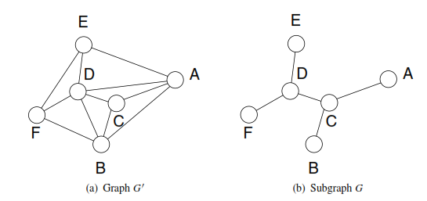


Slide 49
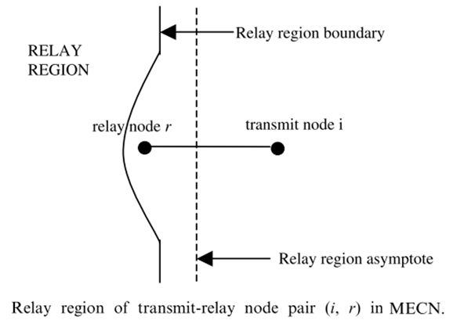
MECN

Slide 50
MECN
Global minimum power paths are found without considering all the nodes in the network.
Two phases:
Constructs a sparse graph (enclosure graph), which consists of all the enclosures of each transmit node in the graph.
Finds optimal links on the enclosure graph by using distributed Bellman–Ford shortest path algorithm with power consumption as the cost metric.

Slide 52
SMECN
Small Minimum Energy Communication Network (SMECN) is an extension to MECN.
In SMECN possible obstacles between any pair of nodes are considered. The network is assumed to be fully connected as in the case of MECN.
The sub-network constructed by SMECN for minimum energy relaying is provably smaller (in terms of number of edges) than the one constructed in MECN if broadcasts are able to reach to all nodes in a circular region around the broadcaster.

Slide 53
Geographical Forwarding Schemes for Lossy Links
Wireless channel is prone to failures and packet errors
MECN or SMECN requires frequent reconstruction of the graph.
To reduce overhead, by deﬁning localized rules, all nodes in the network follow to the rule to forward packets.
Based on the information used, localized forwarding schemes can be classiﬁed into two classes:
Distance-based forwarding
Reception-based forwarding -state of the channel is also incorporated into route decisions.
Selects one of the feasible nodes as the next hop to advance the packet toward the destination.

Slide 54
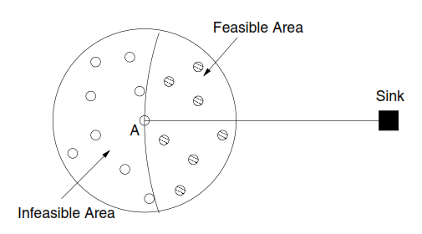
Feasible and Infeasible Regions / Nodes

Slide 55
Greedy Strategies
Greedy Forwarding
Selects the closest node to destination
Most Forward within Radius (MFR)
The node with largest advancement on the line connecting source and destination – (Node M)
Nearest Forward Progress (NFP)
Closest to source that is closer to destination - (Node N)
Greedy Routing Scheme (GRS)
Node closest to destination - (Node G)
Compass
Closest to the straight line between source and destination - (Node C)
Disadvantage – Did not consider the channel quality

Slide 56
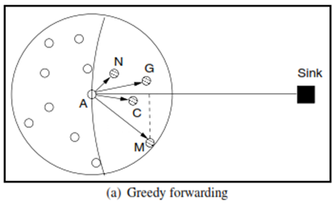
Greedy Strategies

Slide 57
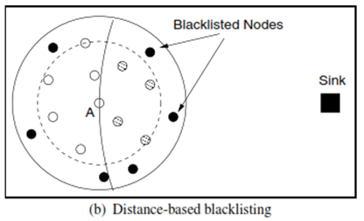
Distance based Black-listing
Considers nodes that are within a threshold distance from source

Slide 58
Reception based Black-listing
Prevents selection of nodes with poor channel quality
Nodes having poor Packet Reception Ratio (PRR)
Absolute PRR
Keeps track of PRR with each of its neighbors and is exchanged periodically
Relative PRR
Orders the neighbors based on PRR and nodes with worst PRR are blacklisted
Best Reception Neighbor Algorithm
Node with highest PRR is selected

Slide 59
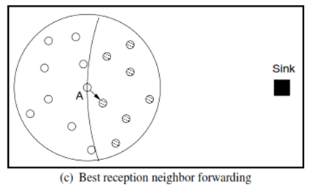

Slide 60

Best PRR x Distance
PRR → Selection of closest node to source → increased no. of hops → increased latency
Selection based on maximum of PRR x distance.
Distance is calculated as

Slide 61
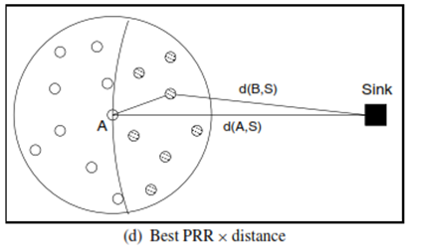

Slide 62

PRADA
Probe based Distributed protocol for knowledge range adjustment
Global topology → costly → higher overhead → increased precision in routing decisions and less energy consumption in data communication
PRADA based on Partial Topology Knowledge Forwarding (PTKF)
Minimizes the cost for topology knowledge gain as well as cost for data communication
Each node constructs a route based on a weighted shortest path algorithm with the link cost given as the energy consumption.
In PTKF next hop is selected by calculating the route according to its topology knowledge.
Finds the optimum set of knowledge range values, R, of each node to minimize the overall energy consumption.
Minimize

Slide 63


PRADA is a distributed version of PTKF
Each node adjusts its knowledge range according to the feedback information it receives from neighbor nodes.
First selects a random knowledge range (KR), r_{current}
Constructs a route to the sink according to its current KR.
Then, each node periodically selects a certain KR, r_{probe} to be probed and calculates
If then
r_{current} = r_{probe}
Faster convergence to optimum route

Slide 64
Qualitative Evaluation
Advantages:
Scalable - neighborhood information is implicitly inferred from the physical placement of nodes.
Low complexity since the next hops can be selected based on local information.
Performance depends on accuracy of knowledge about the location.
Disadvantages:
Error in location detection can cause an error in routing.
If the GPS or location device is damaged, sensor nodes that depend on the device are rendered useless.
Monetary cost for the GPS may be expensive for some applications.
Power consumption and size of the GPS may not be appropriate if sensor nodes are operated by batteries and deployed in their thousands.

